Slide 1

How Data Science will affect Basketball Game?
10 years (2008-2018) field goal data shows that the closer, the higher
24 Feet
10 Feet
4 Feet
Combine the probability with the return, it shows expectation is polarized
Basket
3-point line

Slide 2
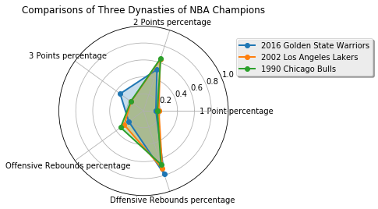
Is the Game Strategy being changed by Data Science?
More 3-point shoots and more Defensive rebounds
High average points, rebounds and assists are still important to win a championship.

Slide 3
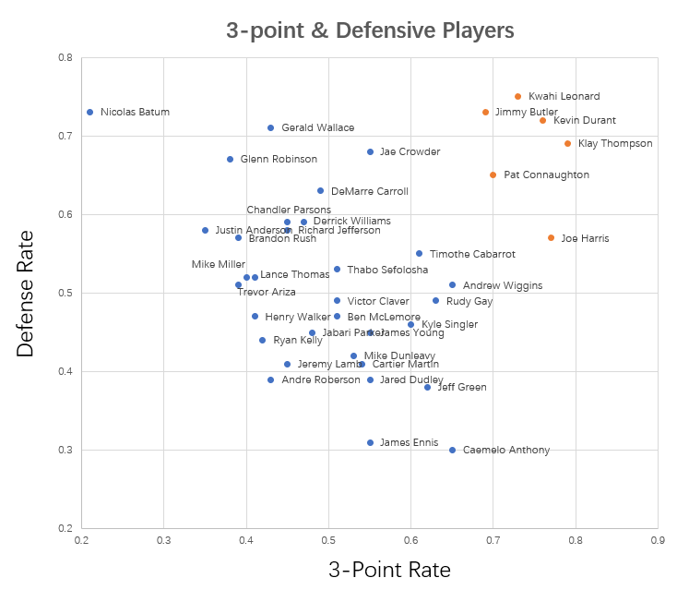
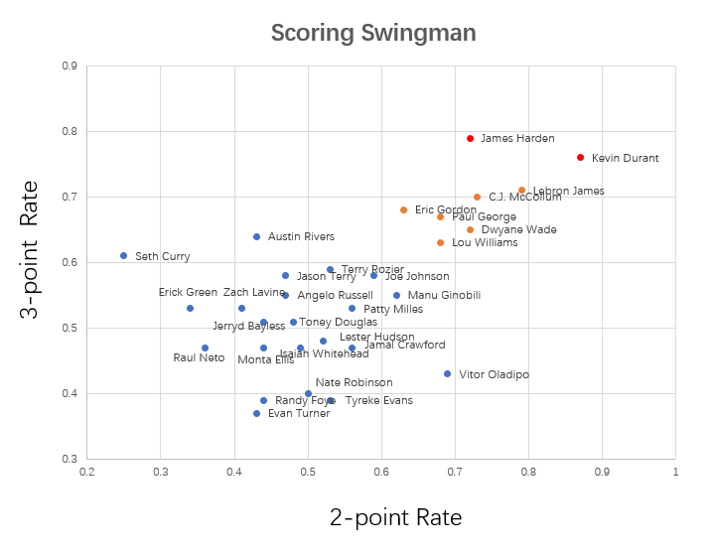
Different Types of Players

Slide 4
NBA International Players Distribution

Slide 5
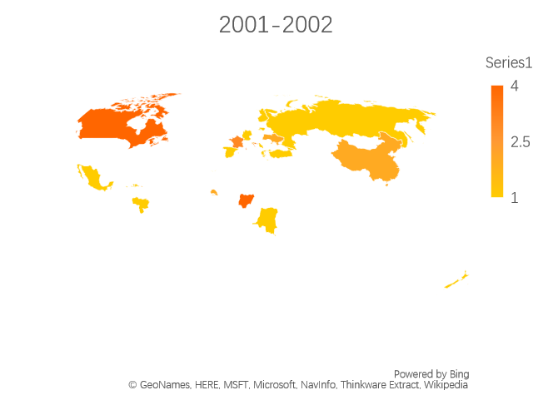
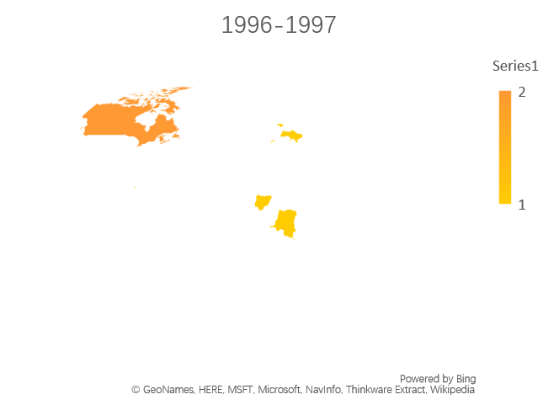
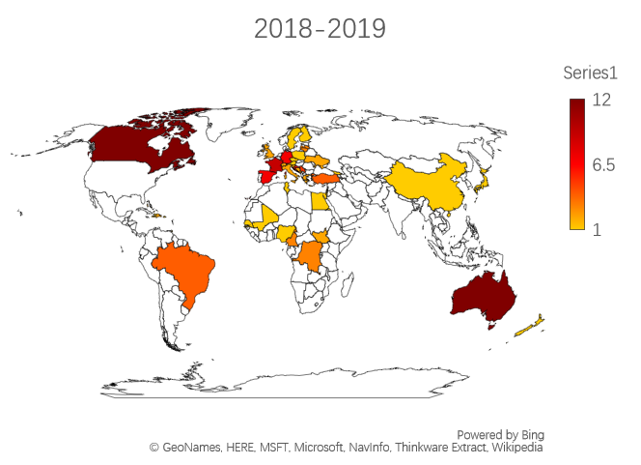
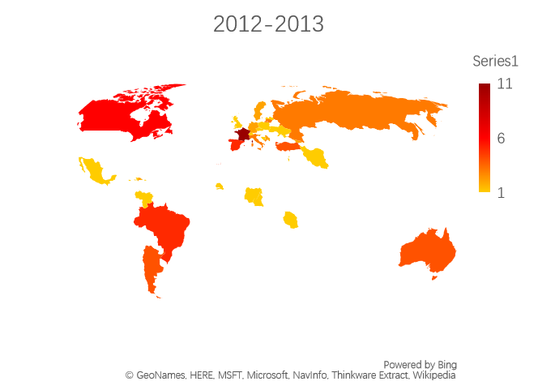
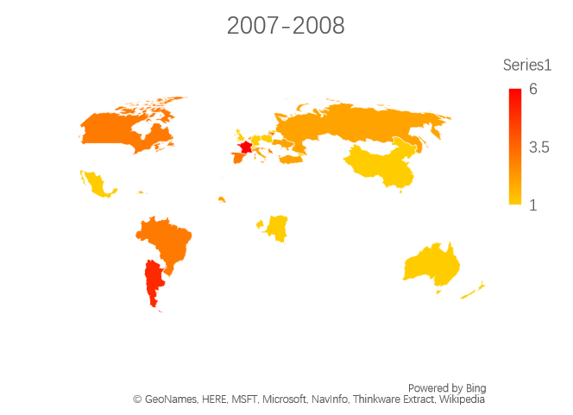
NBA International Players Distribution
Numbers of European players and African players have a steady growth, Asian players are still rare in NBA.

